Slide 1
Fuzzy Logic

Slide 2
WHAT IS FUZZY LOGIC?
Definition of fuzzy
Fuzzy – “not clear, distinct, or precise; blurred”
Definition of fuzzy logic
A form of knowledge representation suitable for notions that cannot be defined precisely, but which depend upon their contexts.
Fuzzy Logic introduced by Lotfi Zadeh, Berkely IN 1965
Notes:
2

Slide 3
Introduction
Fuzzy logic:
A way to represent variation or imprecision in logic
A way to make use of natural language in logic
Approximate reasoning
Humans say things like "If it is sunny and warm today, I will drive fast"
Linguistic variables:
Temp: {freezing, cool, warm, hot}
Cloud Cover: {overcast, partly cloudy, sunny}
Speed: {slow, fast}

Slide 4
Crisp (Traditional) Variables
Crisp variables represent precise quantities:
x = 3.1415296
Tall={x∣x ≥180}
Short={x∣x<180}
A ∈{0,1}
A proposition is either True or False
A ∧ B ⇒ C
King(Richard) ∧ Greedy(Richard) ⇒ Evil(Richard)
Richard is either greedy or he isn't:
Greedy(Richard) ∈{0,1}

Slide 5
Cont.
Tall={x∣x ≥180}
Short={x∣x<180}
Does a person with 179.5 belongs to tall set of short set?
Crisp set will say this person belongs to the short set
Can it be: he belongs 90% to the tall set and 10 to the short set?
Fuzzy sets can define a percentage at which the person belong to one of these sets

Slide 6
Fuzzy Sets
What if Richard is only somewhat greedy?
Fuzzy Sets can represent the degree to which a quality is possessed.
Fuzzy Sets (Simple Fuzzy Variables) have values in the range of [0,1]
Greedy(Richard) = 0.7
Question: How evil is Richard?

Slide 7
Fuzzy Linguistic Variables
Fuzzy Linguistic Variables are used to represent qualities spanning a particular spectrum
Temp: {Freezing, Cool, Warm, Hot}
Membership Function
Question: What is the temperature?
Answer: It is warm.
Question: How warm is it?

Slide 8
Membership Functions
Temp: {Freezing, Cool, Warm, Hot}
Degree of Truth or "Membership"

Slide 9
Membership Functions
How cool is 36 F° ?

Slide 10
Membership Functions
How cool is 36 F° ?
It is 30% Cool and 70% Freezing
It is 0% Worm and 0% Hot
0.7
0.3

Slide 11
Fuzzy Logic
How do we use fuzzy membership functions in predicate logic?
Fuzzy logic Connectives:
Fuzzy Conjunction, ∧
Fuzzy Disjunction, ∨
Operate on degrees of membership in fuzzy sets

Slide 12
Fuzzy Disjunction
A∨B max(A, B)
A∨B = C "Quality C is the disjunction of Quality A and B"
(A∨B = C) ⇒ (C = 0.75)

Slide 13
Fuzzy Conjunction
A∧B min(A, B)
A∧B = C "Quality C is the conjunction of Quality A and B"
(A∧B = C) ⇒ (C = 0.375)

Slide 14
Example: Fuzzy Conjunction
Calculate A∧B given that A is .4 and B is 20

Slide 15
Example: Fuzzy Conjunction
Calculate A∧B given that A is .4 and B is 20
Determine degrees of membership:

Slide 16
Example: Fuzzy Conjunction
Calculate A∧B given that A is .4 and B is 20
0.7
Determine degrees of membership:
A = 0.7

Slide 17
Example: Fuzzy Conjunction
Calculate A∧B given that A is .4 and B is 20
0.9
0.7
Determine degrees of membership:
A = 0.7 B = 0.9

Slide 18
Example: Fuzzy Conjunction
Calculate A∧B given that A is .4 and B is 20
0.9
0.7
Determine degrees of membership:
A = 0.7 B = 0.9
Apply Fuzzy AND
A∧B = min(A, B) = 0.7

Slide 19
Fuzzy Control
Fuzzy Control combines the use of fuzzy linguistic variables with fuzzy logic
Example: Speed Control
How fast am I going to drive today?
It depends on the weather.
Disjunction of Conjunctions

Slide 20
Inputs: Temperature
Temp: {Freezing, Cool, Warm, Hot}

Slide 21
Inputs: Temperature, Cloud Cover
Temp: {Freezing, Cool, Warm, Hot}
Cover: {Sunny, Partly, Overcast}

Slide 22
Output: Speed
Speed: {Slow, Fast}

Slide 23
Rules
If it's Sunny and Warm, drive Fast
Sunny(Cover)∧Warm(Temp)⇒ Fast(Speed)
If it's Cloudy and Cool, drive Slow
Cloudy(Cover)∧Cool(Temp)⇒ Slow(Speed)
Driving Speed is the combination of output of these rules...

Slide 24
Example Speed Calculation
How fast will I go if it is
65 F°
25 % Cloud Cover ?

Slide 25
Fuzzification: Calculate Input Membership Levels
65 F° ⇒ Cool = 0.4, Warm= 0.7

Slide 26
Fuzzification: Calculate Input Membership Levels
65 F° ⇒ Cool = 0.4, Warm= 0.7
25% Cover ⇒Sunny = 0.8, Cloudy = 0.2

Slide 27
...Calculating...
If it's Sunny and Warm, drive Fast
Sunny(Cover)∧Warm(Temp)⇒Fast(Speed)
0.8 ∧ 0.7 = 0.7
⇒ Fast = 0.7
If it's Cloudy and Cool, drive Slow
Cloudy(Cover)∧Cool(Temp)⇒Slow(Speed)
0.2 ∧ 0.4 = 0.2
⇒ Slow = 0.2

Slide 28
Defuzzification: Constructing the Output
Speed is 20% Slow and 70% Fast
Find centroids: Location where membership is 100%

Slide 29
Defuzzification: Constructing the Output
Speed is 20% Slow and 70% Fast
Find centroids: Location where membership is 100%

Slide 30
Defuzzification: Constructing the Output
Speed is 20% Slow and 70% Fast
Speed = weighted mean
= (2*25+...

Slide 31
Defuzzification: Constructing the Output
Speed is 20% Slow and 70% Fast
Speed = weighted mean
= (0.2*25+0.7*75)/(0.9)
= 63.8 mph

Slide 32
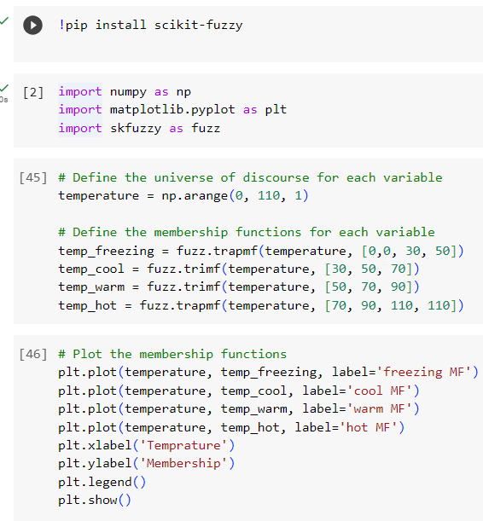
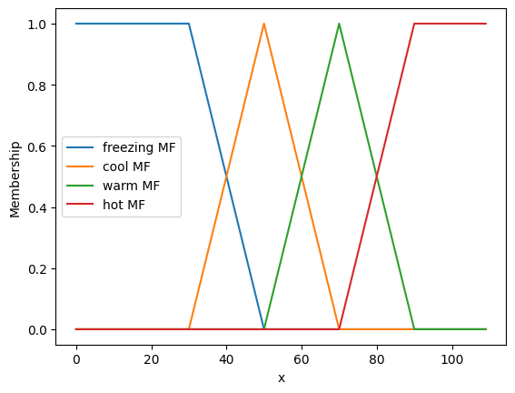
Implementation using Python
Temperature

Slide 33
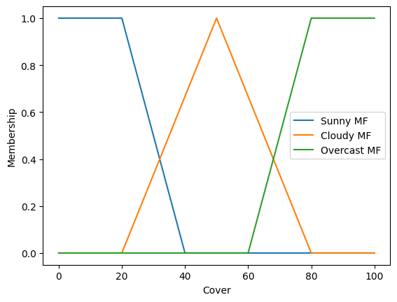
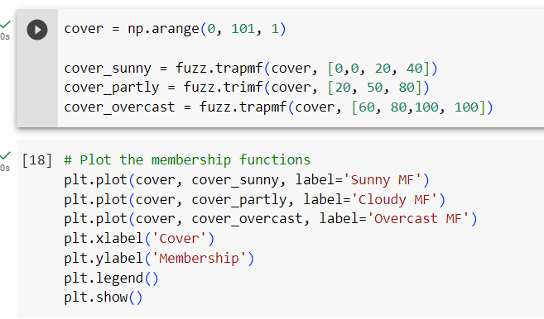
Cover

Slide 34
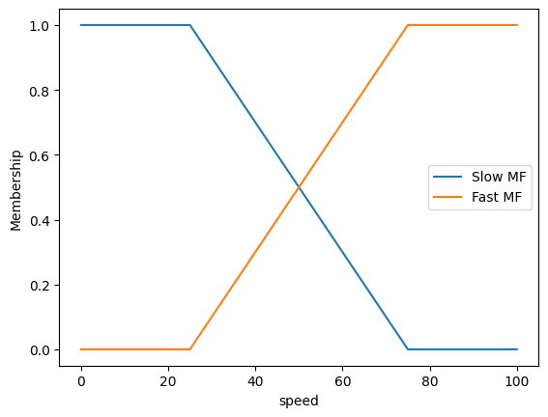
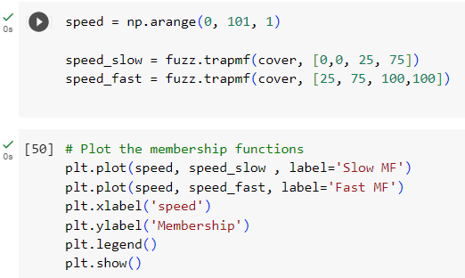
Speed

Slide 35
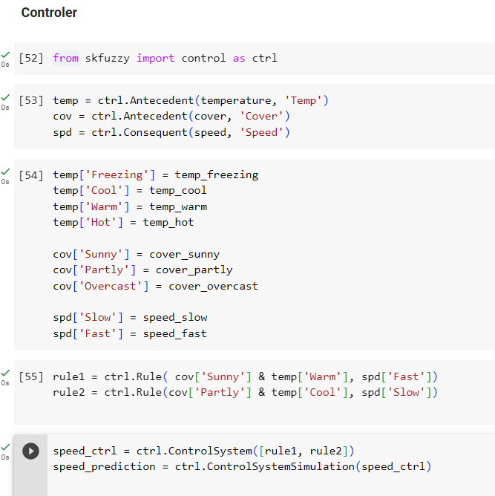
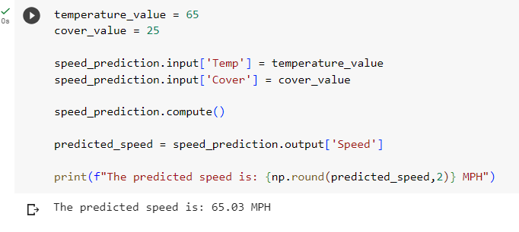
Controller

Slide 36
Example: Height
Tall people: say taller than or equal to 1.8m
1.8m , 2m, 3m etc. member of this set
1.0 m, 1.5m or even 1.79999m not a member
so, near the border lines, many misclassifications

Slide 37
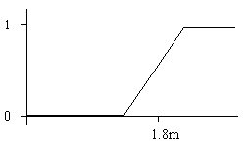
Member Functions example
Membership function
better than listing membership values
1 if x >= 1.9m ,
e.g. Tall(x) = 0 if x <= 1.7m
else ( x - 1.7 ) / 0.2 }
1.7
1.9m

Slide 38
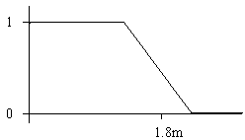
Example: Fuzzy Short
0 if x >= 1.9m ,
Short(x) = 1 if x <= 1.7m
else ( 1.9 - x ) / 0.2

Slide 39
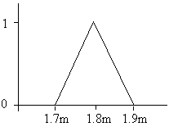
Example: Fuzzy Medium
0 if x >= 1.90 or x < 1.70,
Medium ( x ) = (1.90 - x)/0.1 if x >= 1.80 and x < 1.90,
(x- 1.70)/0.1 if x >= 1.70 and x < 1.80

Slide 40
Notes: Drawbacks to Fuzzy logic
Requires tuning of membership functions
Fuzzy Logic control may not scale well to large or complex problems
Deals with imprecision, and vagueness, but not uncertainty

Slide 41
Summary
Fuzzy Logic provides way to calculate with imprecision and vagueness
Fuzzy Logic can be used to represent some kinds of human expertise
Fuzzy Membership Sets
Fuzzy Linguistic Variables
Fuzzy AND and OR
Fuzzy Control

Slide 42
Home work (using python)
If height is Short and weight is Light then feet are Small
Short( height) AND Light(weight) => Small(feet)
If height is 1.7m and weight is 55kg
what is the value of Size(feet)

